Slide 1

DATA VISUALIZATION OF
MOTOR VEHICLE COLLISIONS

Slide 2

OBJECTIVE
The objective of our analysis is to delve into the data surrounding Motor Vehicle Collisions happened during 2018-2021 in New York City with the aim of identify high-risk areas, collision hotspots, examining temporal trends to uncover patterns and variations in collision rates over different time periods.
Through this analysis, insights will be delivered to stakeholders, including city planners, policymakers, and law enforcement agencies to inform targeted interventions and safety initiatives.

Slide 3
DATA DESCRIPTION
Introduction: Unveiling the Realities of NYC Motor Vehicle Collisions Crashes
This dataset contains information about motor vehicle collisions crashes in New York City from 2012 - 2024. Our main aim is to deliver insights focusing on the years 2018 through 2021.
The Data set contains 2076252 rows and 29 columns which includes Crash date & Time, Borough, No of persons injured and Killed, contributing factor, vehicle type etc.
Prior to Visualization, the data underwent techniques like cleaning and filtering to remove missing values and irrelevant information, feature engineering and the cleaned data consists of 2076252 rows and 29 columns.

Slide 4
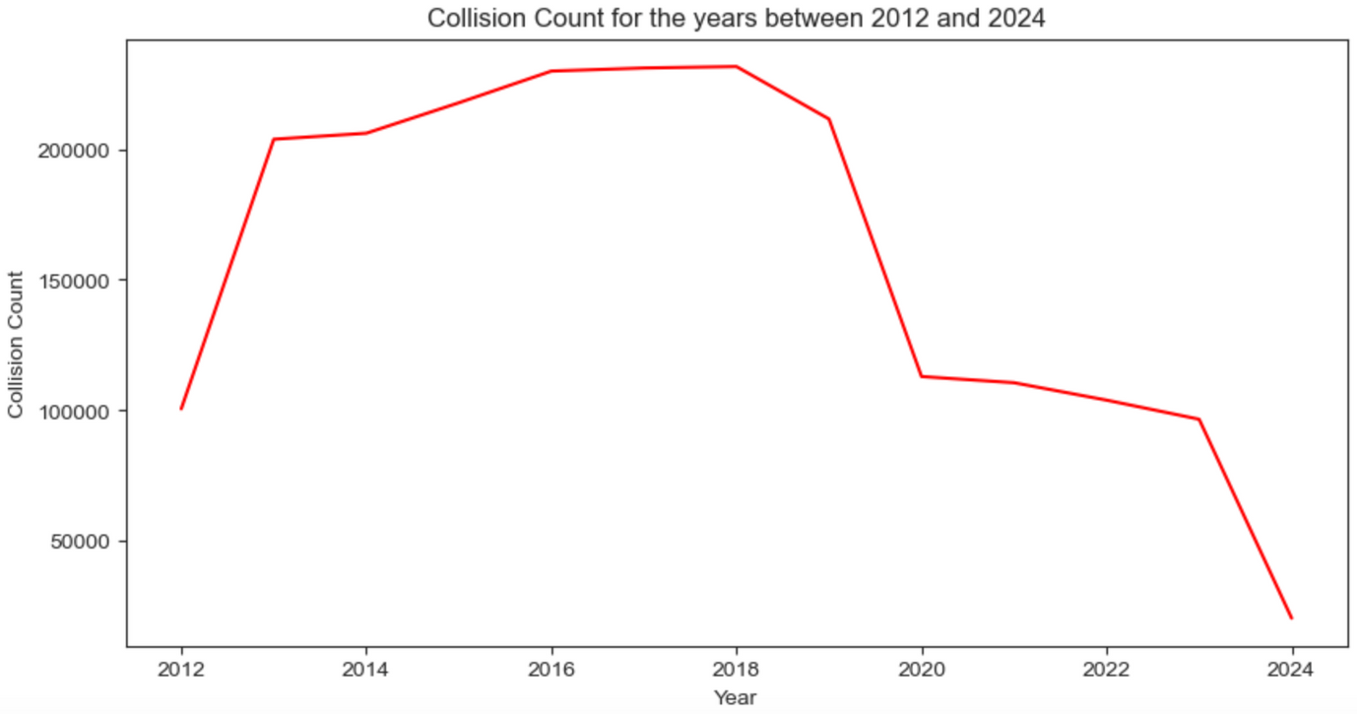

YEARLY COLLISION COUNTS : A COMPREHENSIVE OVERVIEW
Collision Counts were recorded high in the years 2013 - 2019
Highest collision counts - 2018
Least collision counts - 2023

Slide 5

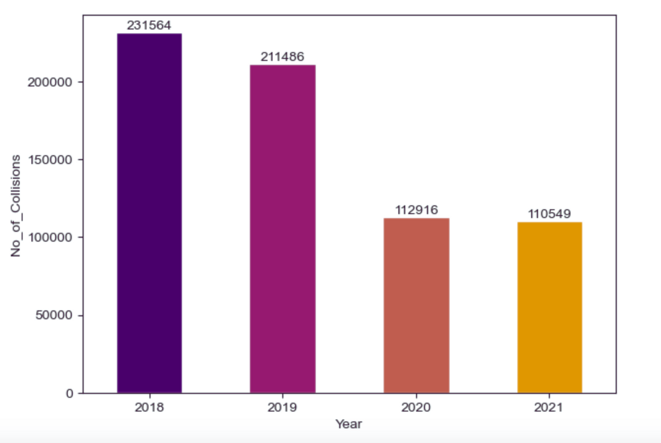
COLLISION COUNTS (2018-2021)
Highest collision counts - 2018
Lowest collision counts - 2021
The Covid-19 lockdown was the main reason for the lower count of collisions in the years 2020 and 2021.

Slide 6
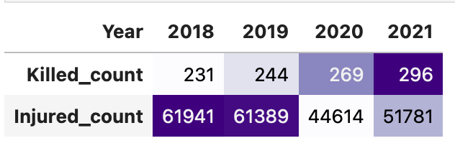
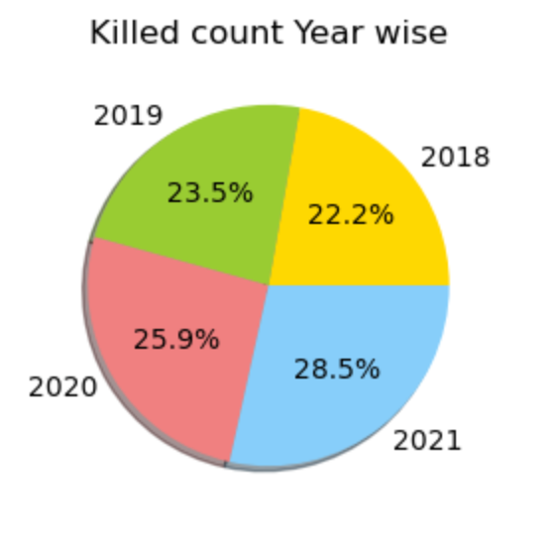
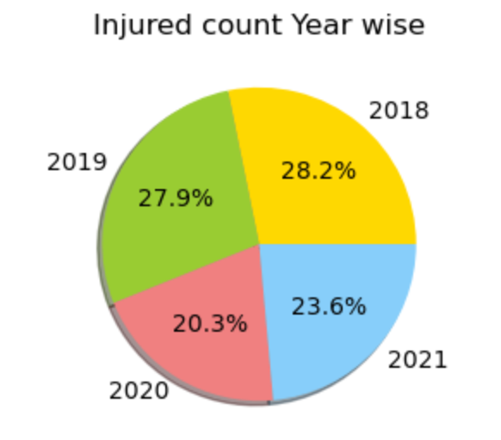
RATIO OF INJURED & KILLED COUNT
Highest Injured count- 2018 followed by 2019
Lowest Injured count - 2020
Highest Killed count - 2021
Lowest Killed count - 202
We can observe that the total number of counts of killed and injured individuals is less than the total number of collisions that occurred, indicating that there were some collisions where only property damage took place.

Slide 7
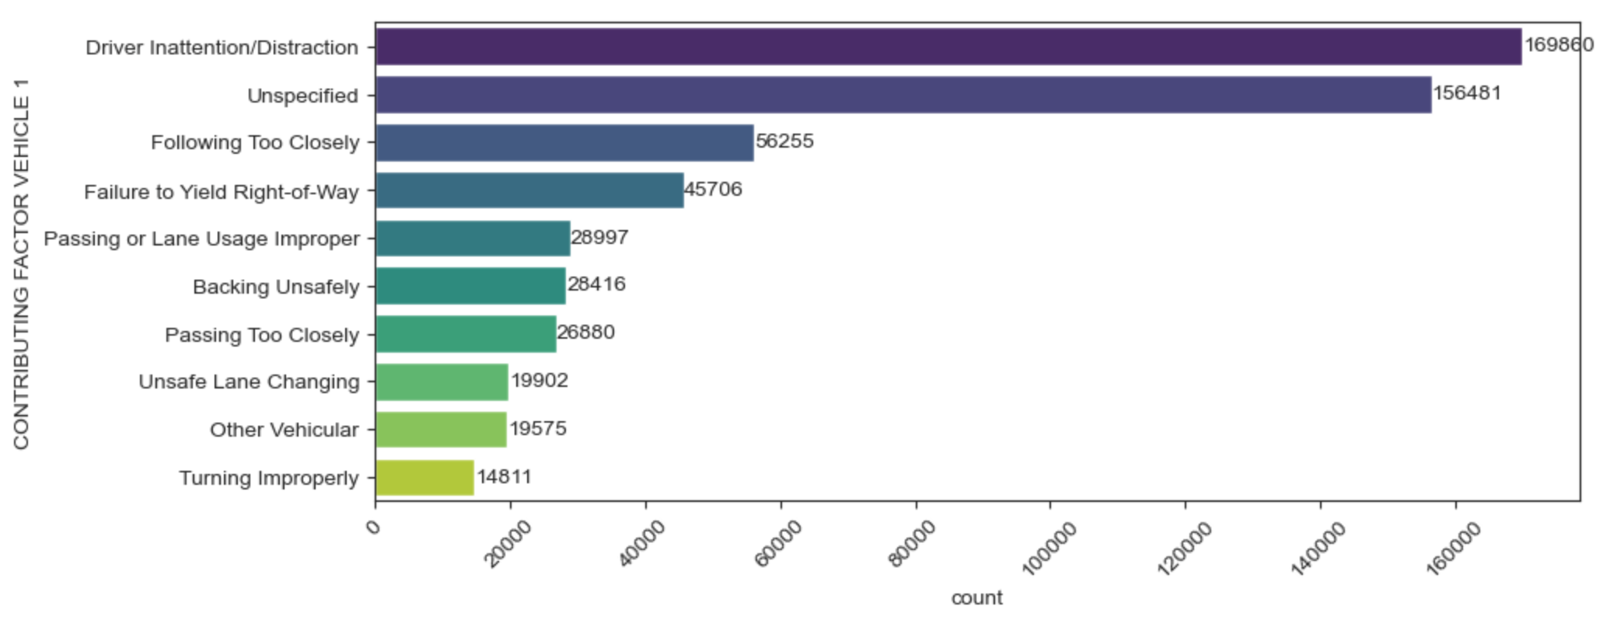
TOP 10 CONTRIBUTING FACTORS FOR COLLISIONS
The top most reason for the occurrence of collisions is driver inattention/distraction

Slide 8
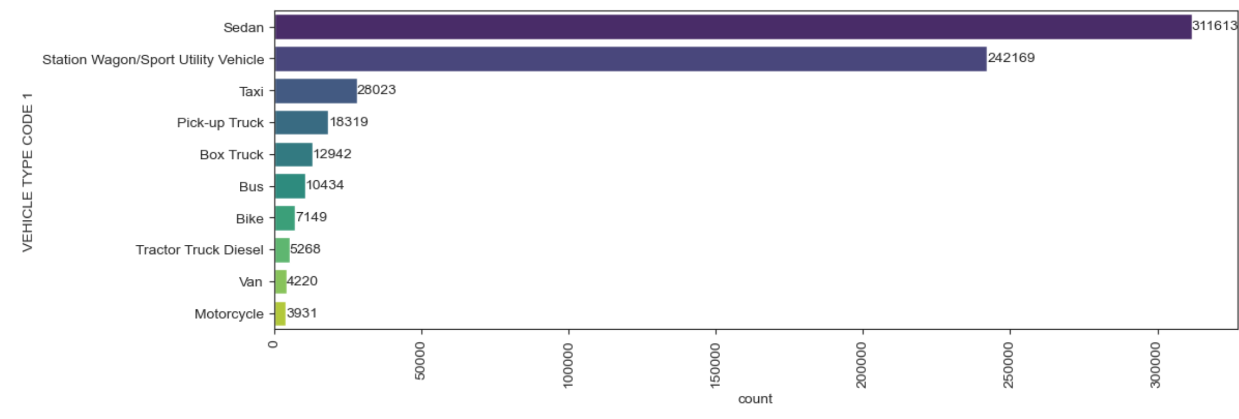
TOP 10 VEHICLES INVOLVED IN COLLISIONS
Sedan is the top most vehicle that involved in the collisions followed by Station Wagon, taxi

Slide 9
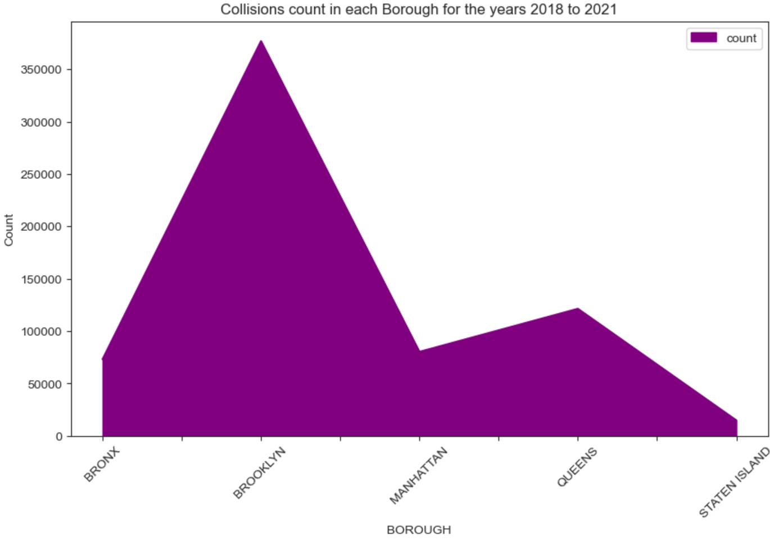
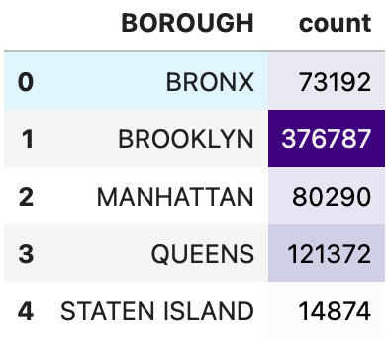
COLLISION COUNTS BY BOROUGH
We can observe that the most collisions occurred in Brooklyn, while the fewest collisions occurred in Staten Island. Given that Brooklyn is the most populous borough in NYC, it is likely that the higher population density contributes to a greater number of collisions

Slide 10
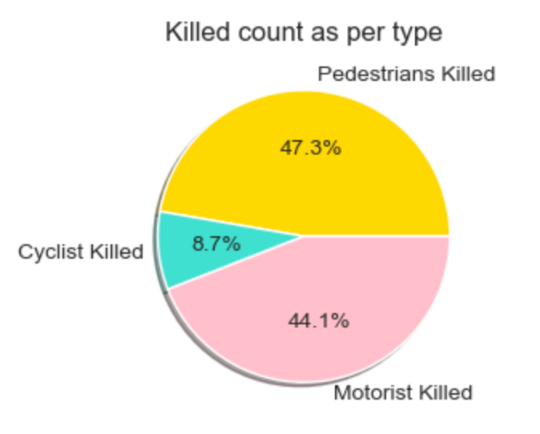
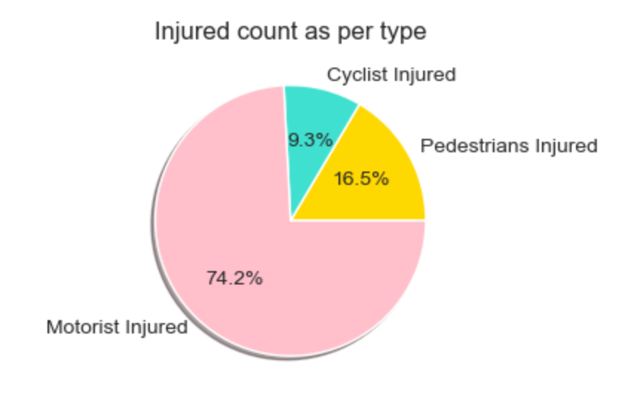
INJURIES AND FATALITIES CATEGORIZED BY TYPE
The majority of pedestrian collisions resulted in fatalities, with only a few sustaining injuries.
Motorists experienced the highest number of injuries, with fatalities also occurring.
Cyclists were involved in relatively few collisions, with only a small number experiencing injuries or fatalities.

Slide 11
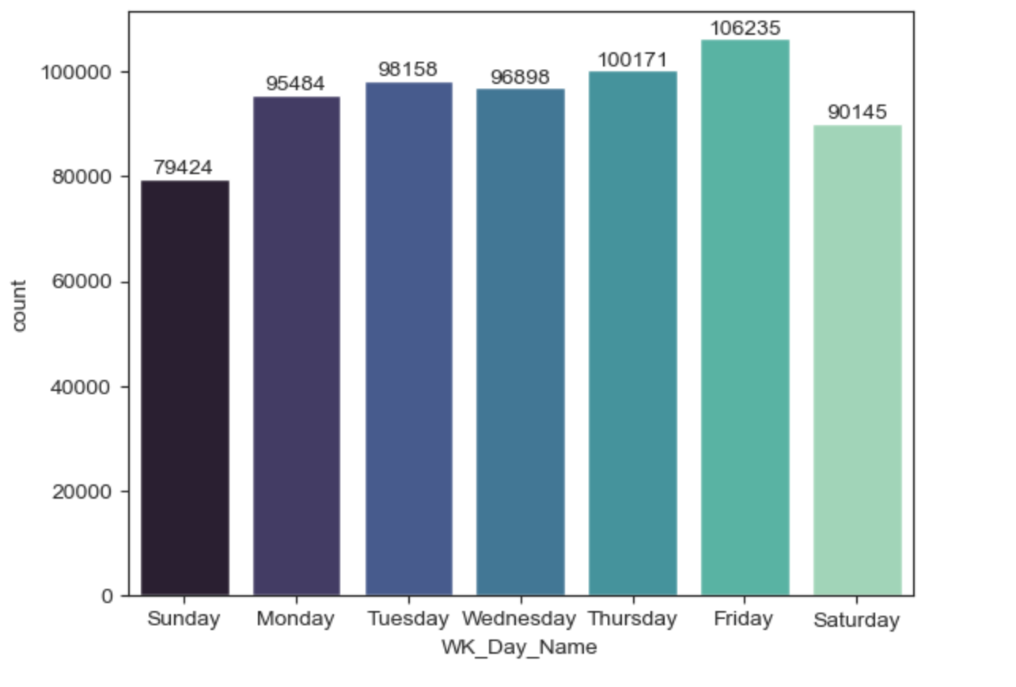
DAY-WISE FREQUENCY OF COLLISIONS
We observe that the highest number of collisions occurred on Friday, followed by Thursday.
Collisions are more frequent on weekdays compared to weekends.
Sundays: Interestingly, Sundays show lower counts of collisions, suggesting a possible trend of reduced outdoor activity and traffic on weekends.

Slide 12
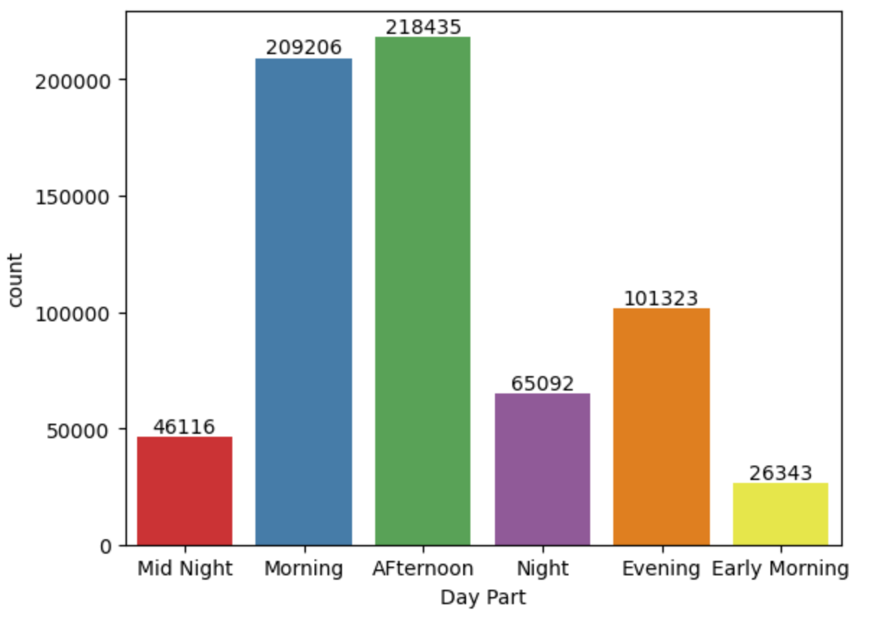
TIMING OF COLLISIONS: ANALYZING PEAK HOURS OF INCIDENTS
We observe that the highest number of collisions occurred during day time i.e. Morning and Afternoon
Collisions are more frequent on weekdays compared to weekends.
Note:
3 - 5 : Early mrng
6 -12 : Morning
13 - 17 : Afternoon
18 -20 : Evening
21- 24 :Night
rest : mid night

Slide 13
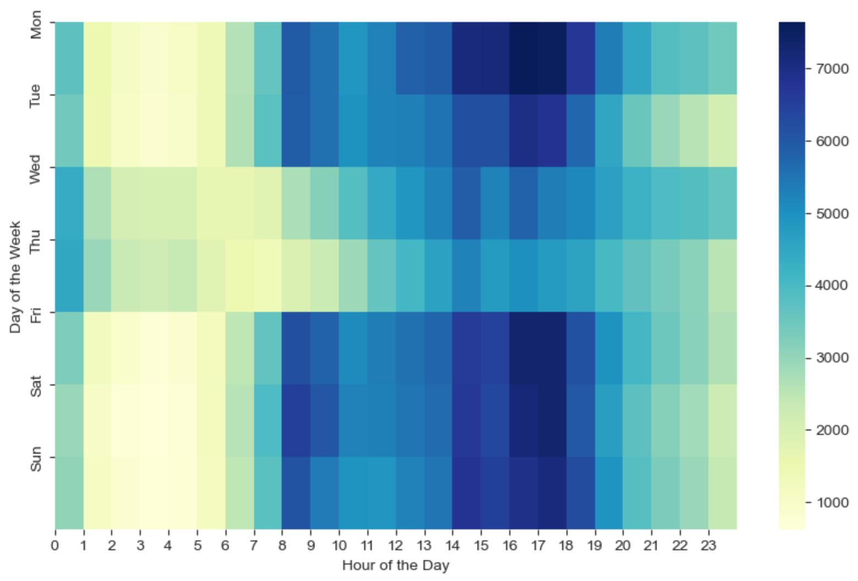
DISTRIBUTION OF COLLISIONS
BY DAY OF THE WEEK & HOUR OF THE DAY
Throughout the week, the majority of collisions occurred between 8 AM and 7 PM, indicating heightened activity during daytime hours.
Peak collision times on Monday, Tuesday, Friday, Saturday, and Sunday were observed between 2 PM and 6 PM
Only few collisions occurred between 1 AM and 7 AM

Slide 14
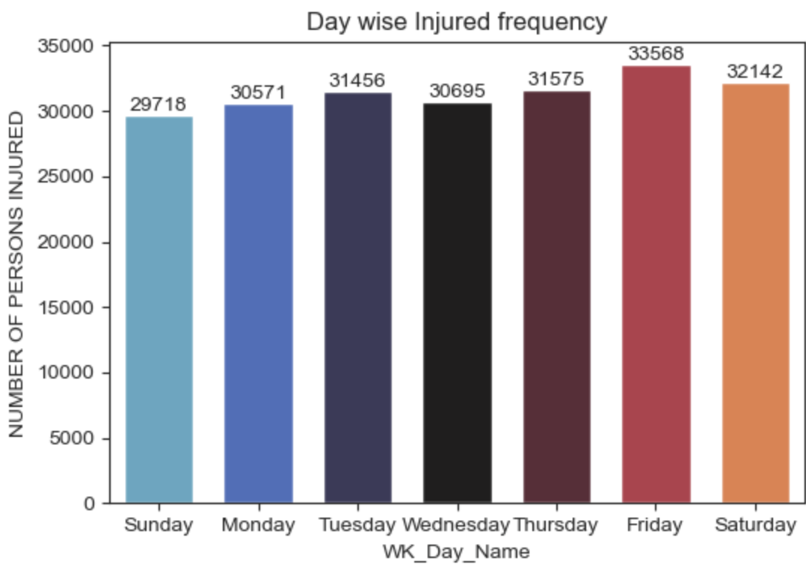
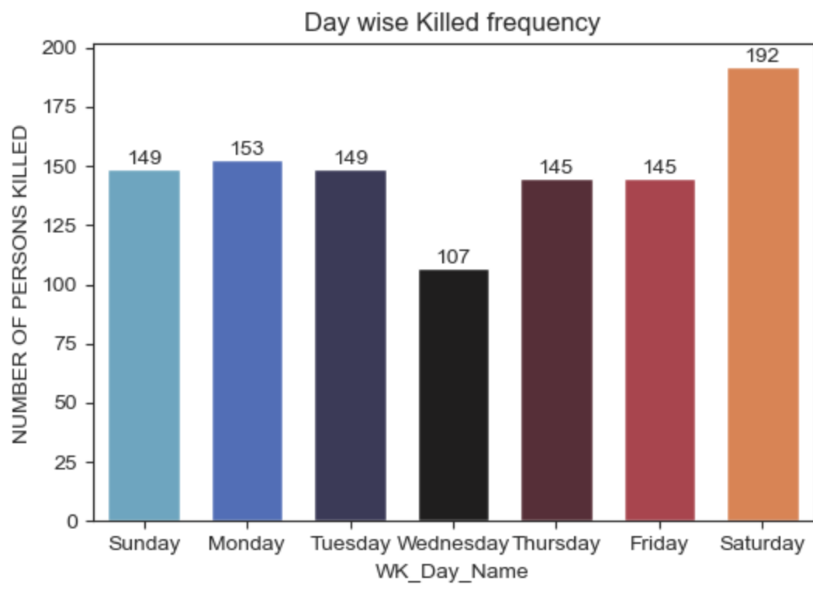
DAY-WISE ANALYSIS: FREQUENCY OF INJURED & KILLED
Friday: The count of injuries peaks on Fridays, possibly due to increased traffic and higher activity levels.
Weekends: Saturdays, being weekends, exhibit higher counts of both injuries and fatalities. This could be attributed to increased traffic volume and potentially reckless driving behaviors.
Weekdays: Throughout the weekdays, the count of both injured & killed remains relatively consistent.
Sundays: Interestingly, Sundays show lower counts of injuries and fatalities, suggesting a possible trend of reduced outdoor activity and traffic on weekends.

Slide 15
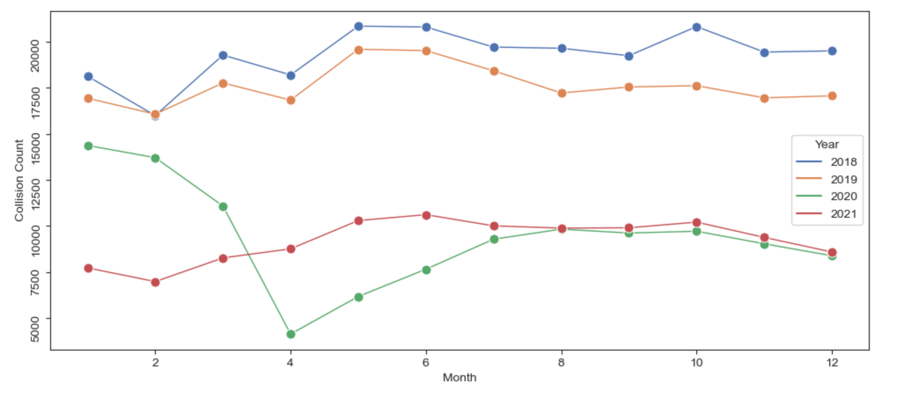
YEARLY ANALYSIS: Monthly Count of collisions
In 2018, collision counts were particularly high in May, June, and October. Interestingly, the collision count trend remained relatively consistent between 2018 and 2019. However, in 2020 and 2021, counts were significantly lower due to the COVID-19 pandemic lockdown. Despite this, there was an observable increase in counts after April in both years.

Slide 16
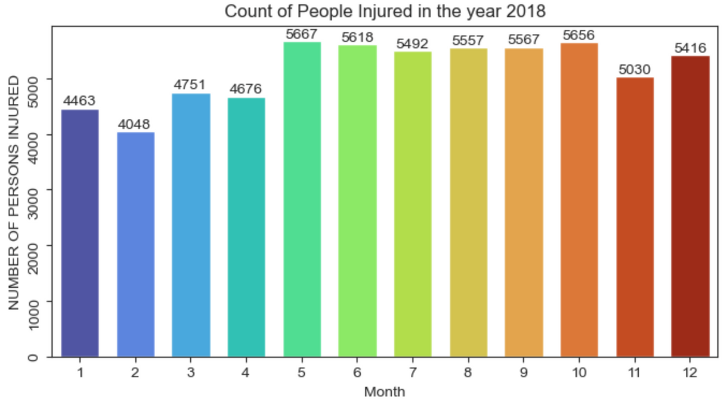
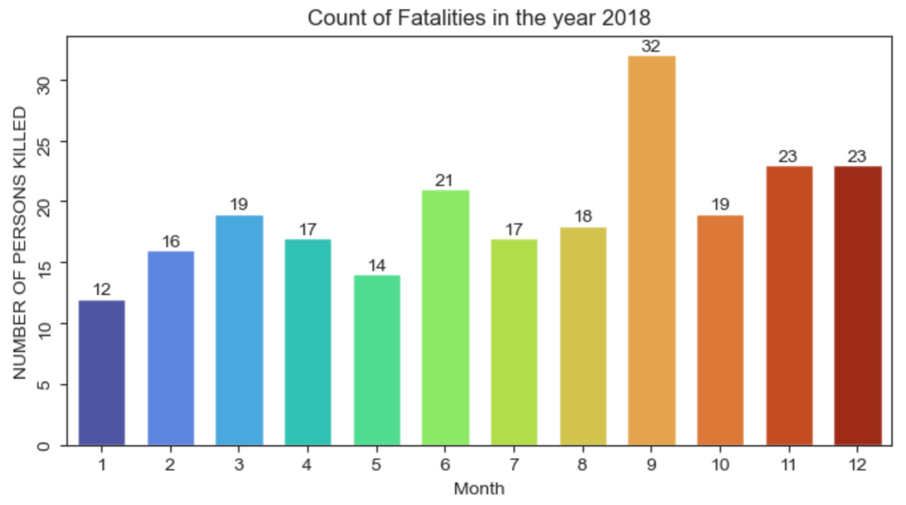
YEARLY ANALYSIS:
MONTHLY COUNT OF INJURIES AND FATALITIES (2018)
The highest count of injuries was observed in May, followed by Oct, June, Aug, and Sep, while the lowest count was recorded in February.
Fatalities were most prevalent in September, followed by Nov, Dec, and June.

Slide 17
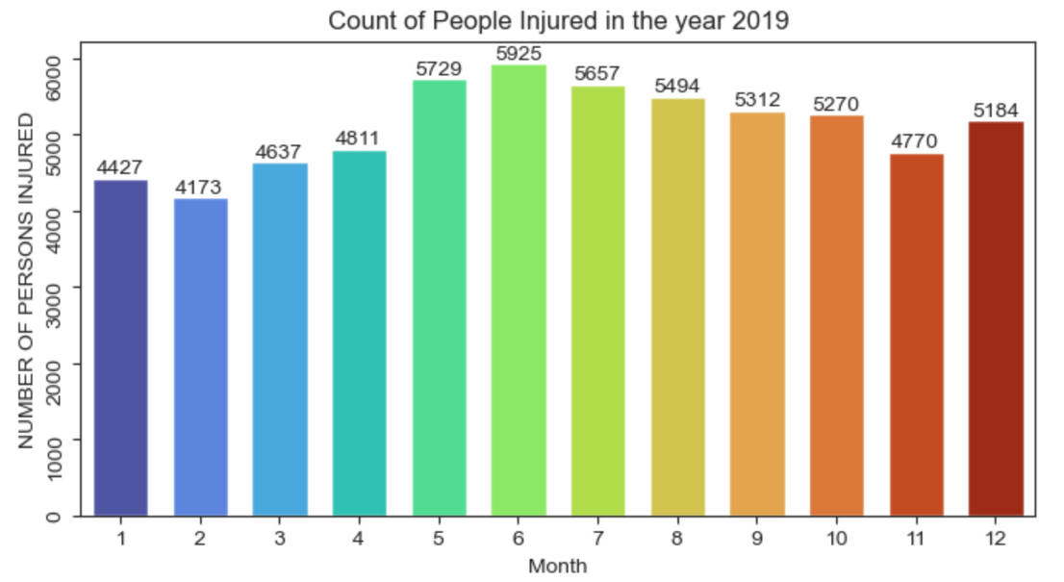
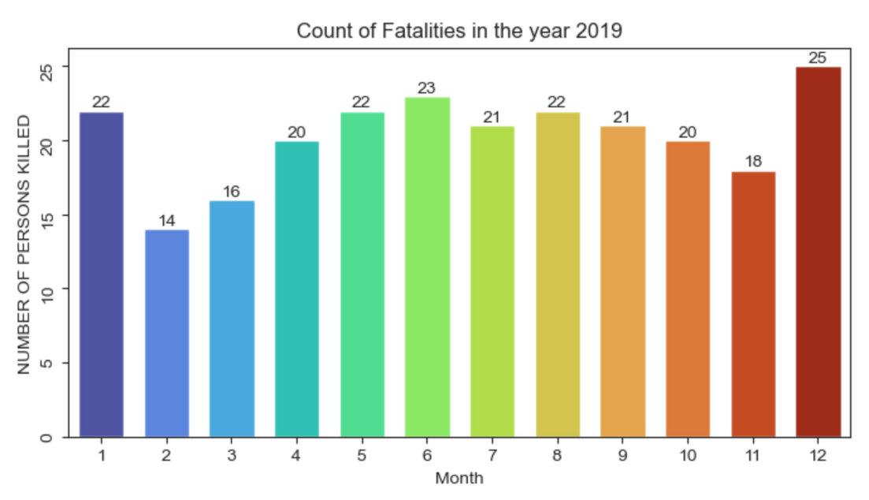
YEARLY ANALYSIS:
MONTHLY COUNT OF INJURIES AND FATALITIES (2019)
The highest count of injuries was observed in June, followed by May, July, Aug, and Sep, while the lowest count was recorded in February.
Fatalities were highest in Dec, followed by Jan, and were prevalent in nearly all months. However, they were lowest in Feb

Slide 18
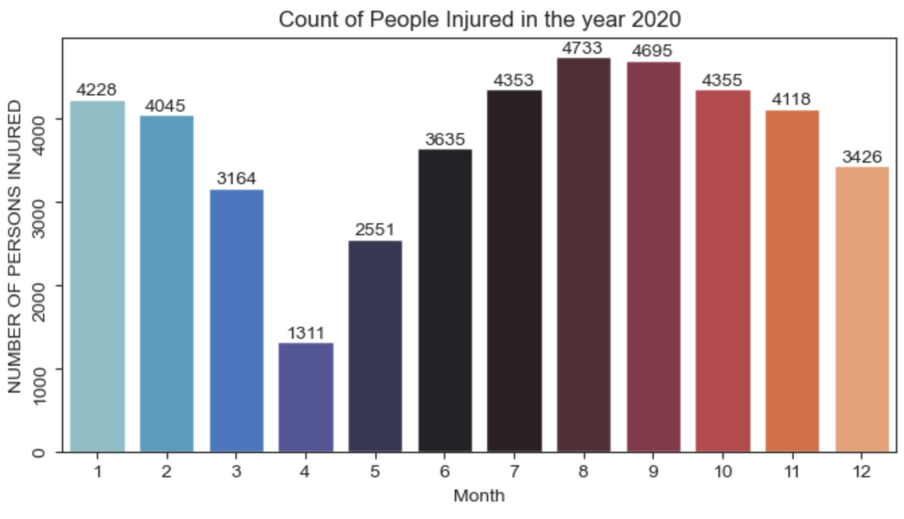
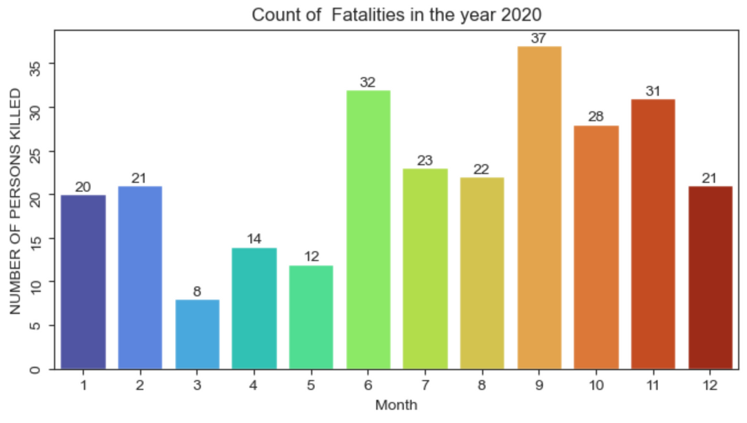
YEARLY ANALYSIS:
MONTHLY COUNT OF INJURIES AND FATALITIES (2020)
The highest count of injuries was observed in Aug, followed by Sep, July and Oct, while the lowest count was recorded in April .
Fatalities were highest in Sep followed by June, Nov, Oct, while the lowest count was recorded in March.

Slide 19
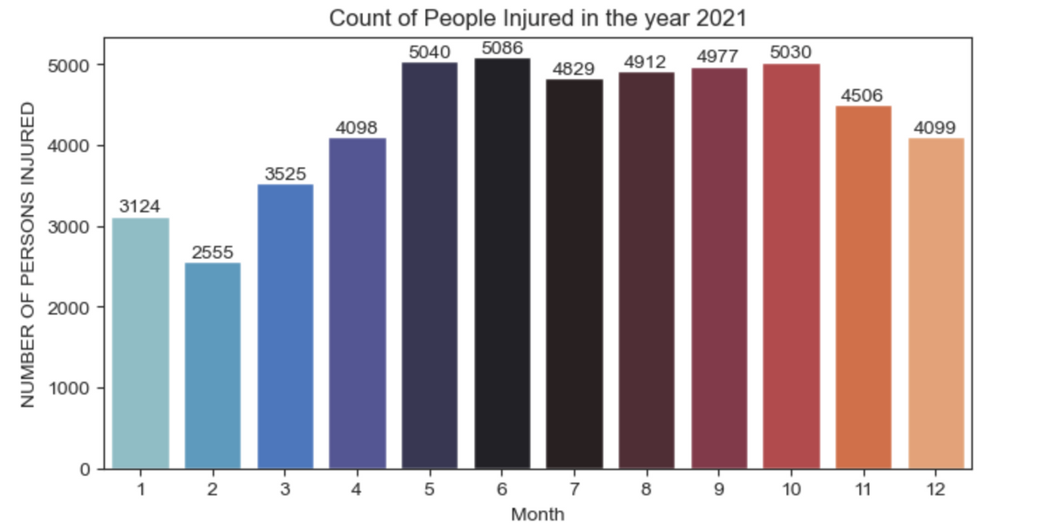
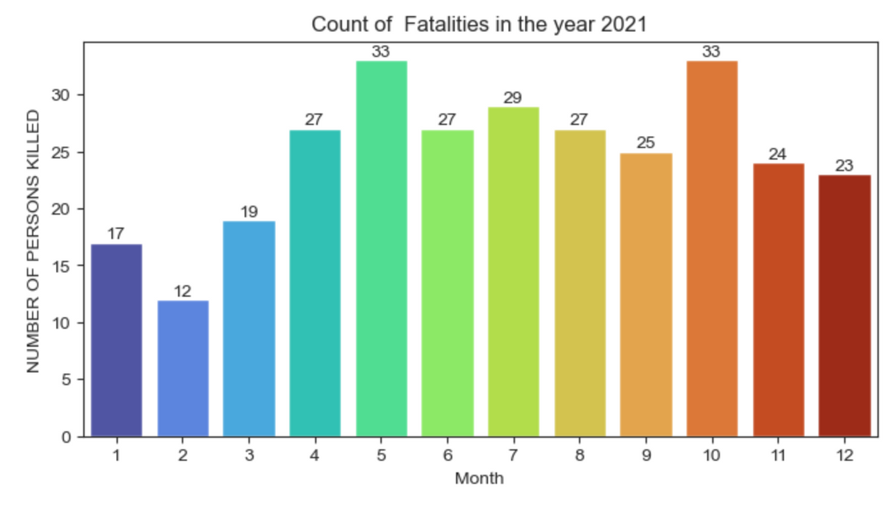
YEARLY ANALYSIS:
MONTHLY COUNT OF INJURIES AND FATALITIES (2021)
The highest count of injuries was observed in June, followed by May and Oct, while the lowest count was recorded in Feb.
Fatalities were highest in May, Oct while the lowest count was recorded in Feb.

Slide 20
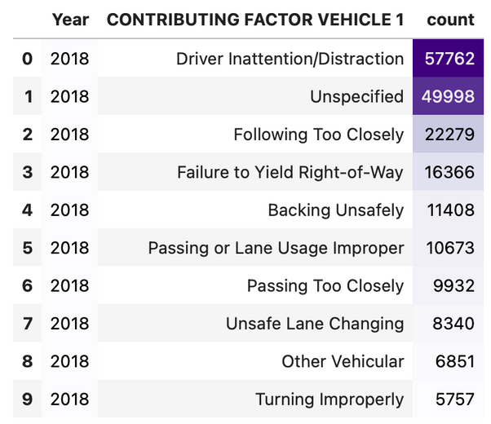
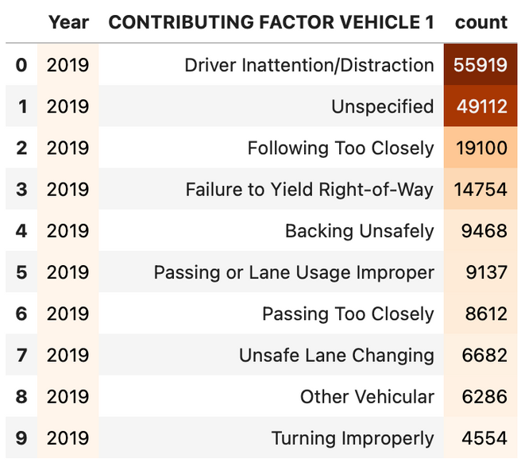
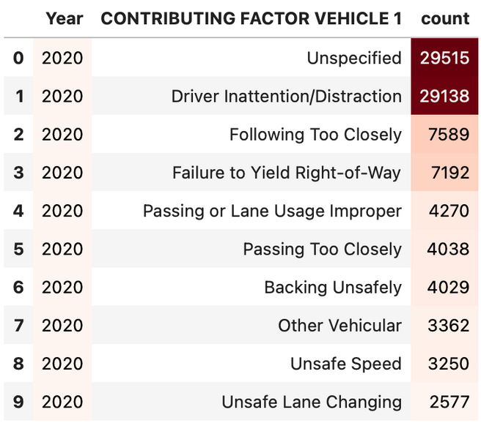
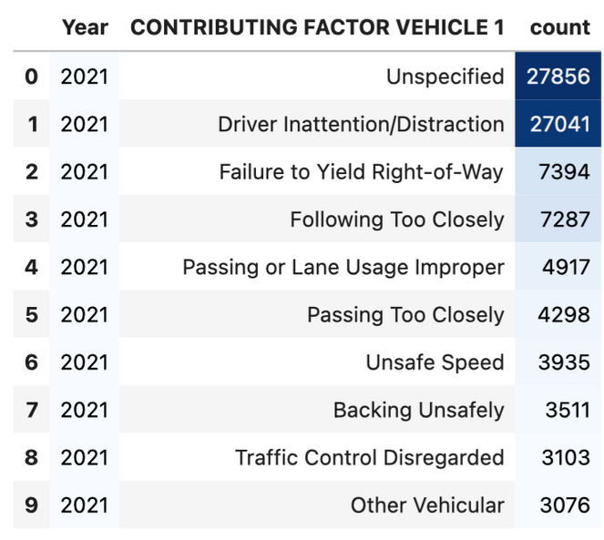
TOP CONTRIBUTING FACTOR VEHICLE
The top contributing factors to collisions across all years were driver inattention/distraction, following too closely, and failure to yield right of way.

Slide 21
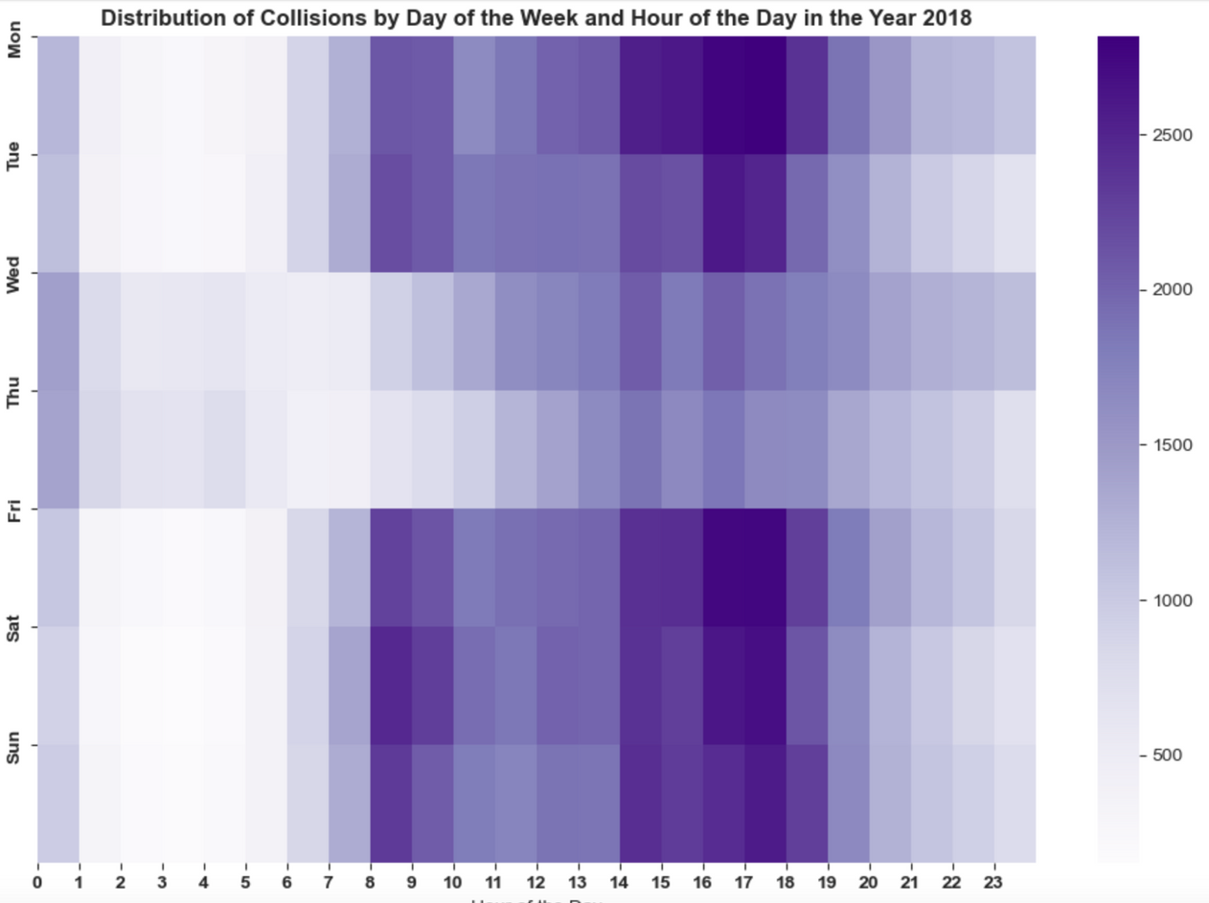
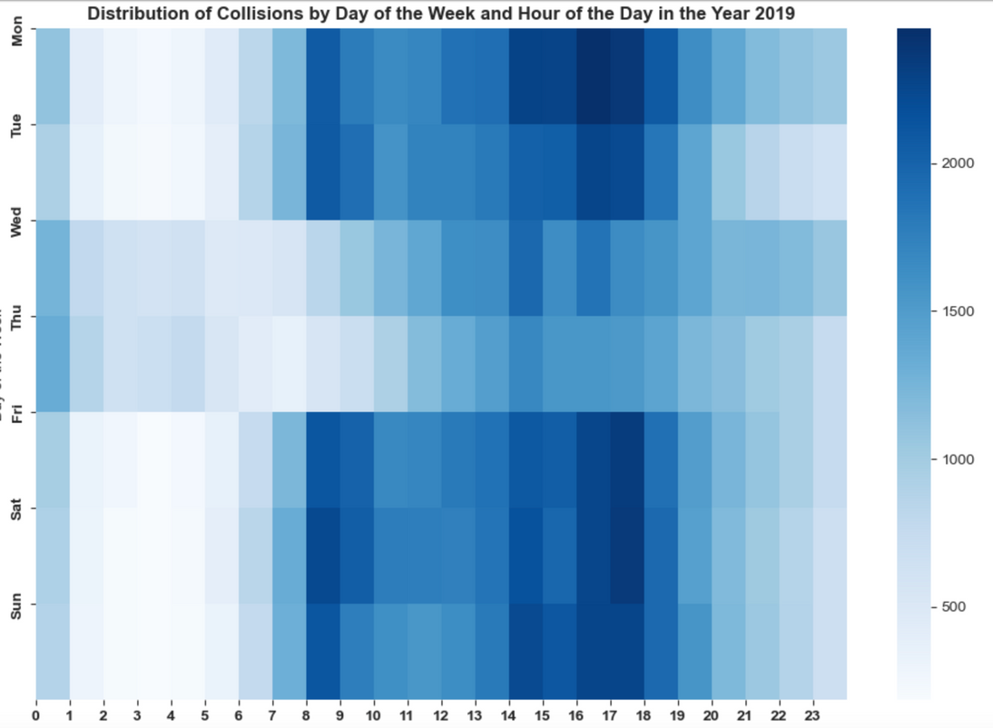
DISTRIBUTION OF COLLISIONS BY DAY OF THE WEEK AND HOUR OF THE DAY

Slide 22
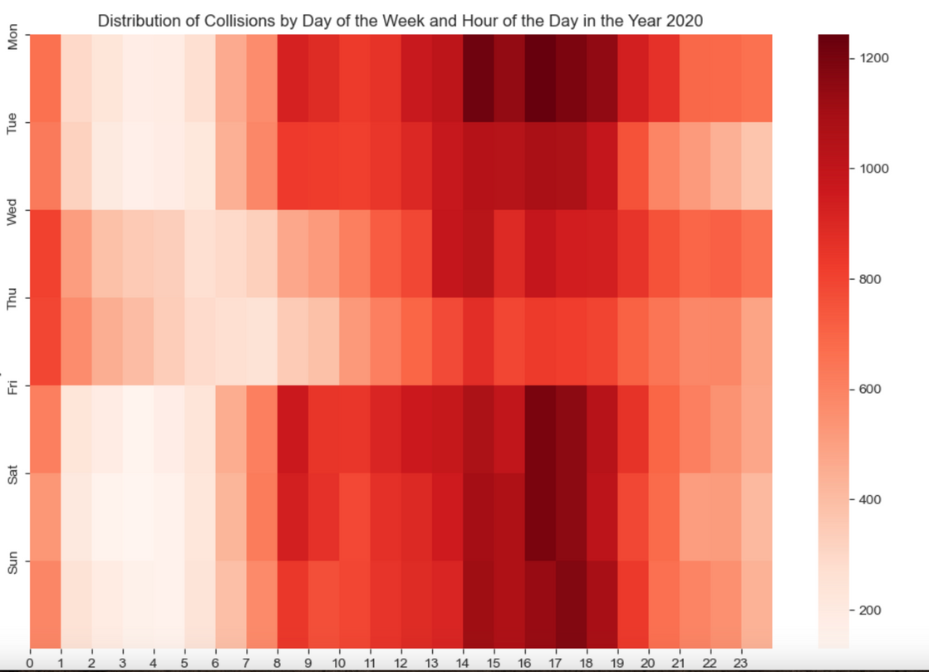
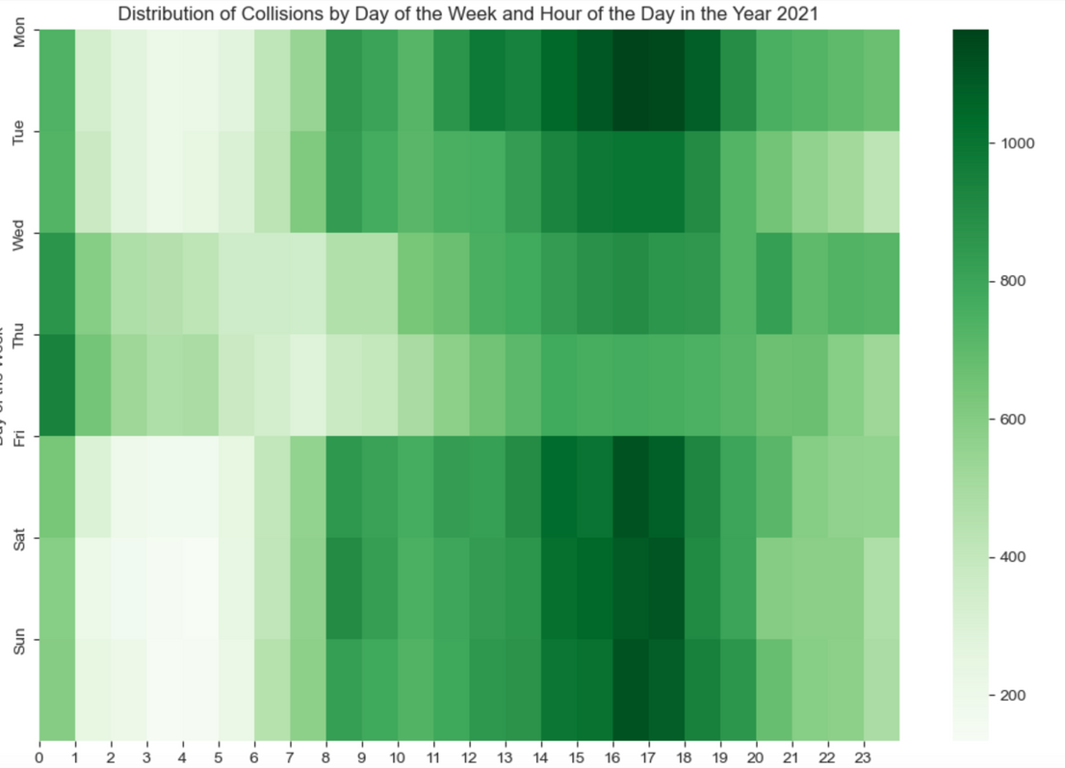
DISTRIBUTION OF COLLISIONS BY DAY OF THE WEEK AND HOUR OF THE DAY

Slide 23
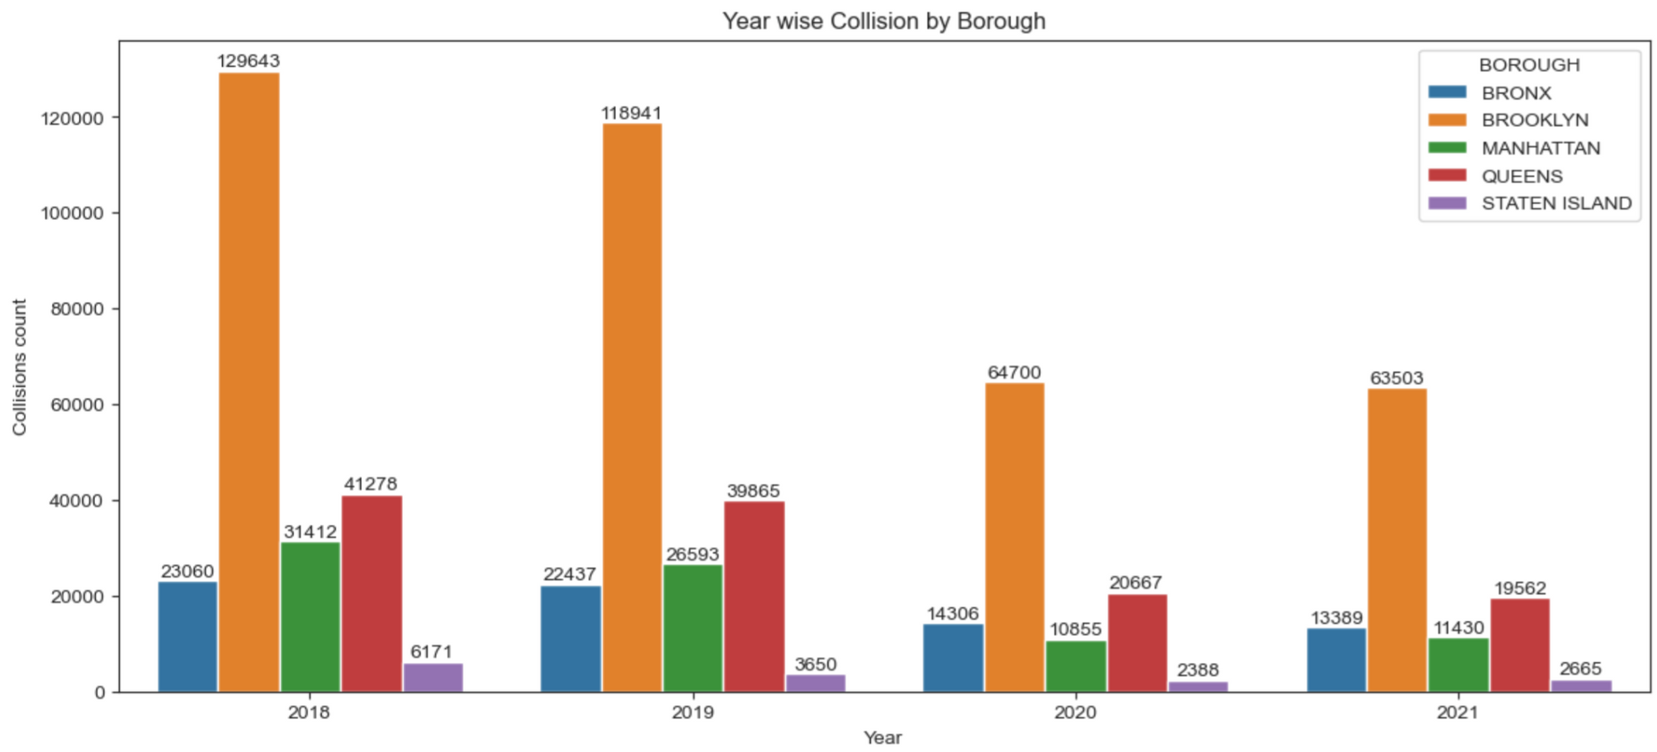
YEAR-WISE COLLISION COUNTS IN EACH BOROUGH
We observe that each year, collisions are most frequent in Brooklyn, followed by Queens, while Staten Island consistently experiences the lowest number of collisions
Brooklyn, with its highest population density among the boroughs, also records the highest number of collisions. Conversely, Staten Island, with its lower population density, experiences fewer collisions
Collision rates are influenced by factors such as population density, road infrastructure, and the enforcement of safety measures. Let’s analyze Brooklyn borough collision details.

Slide 24
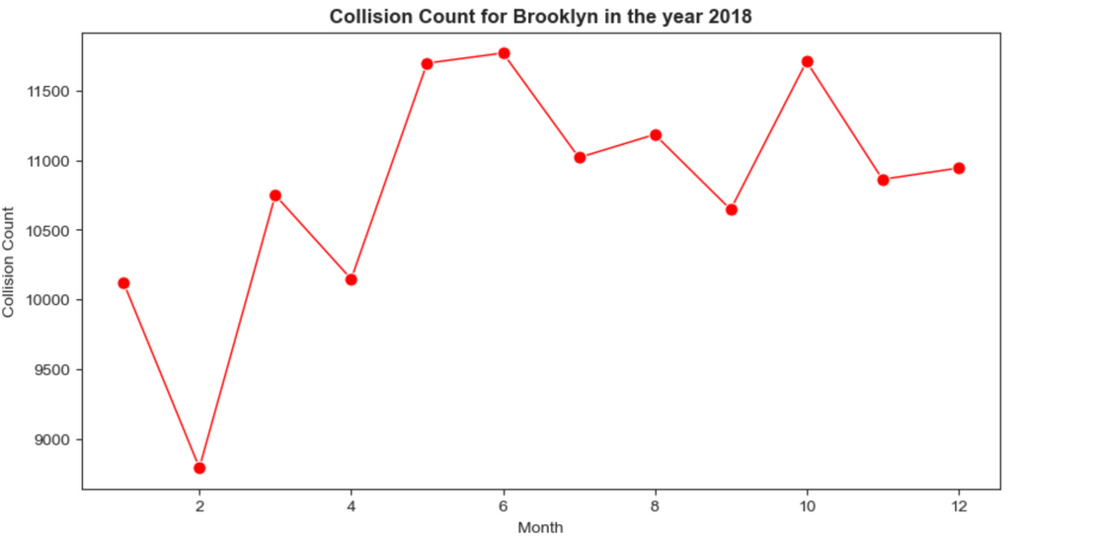
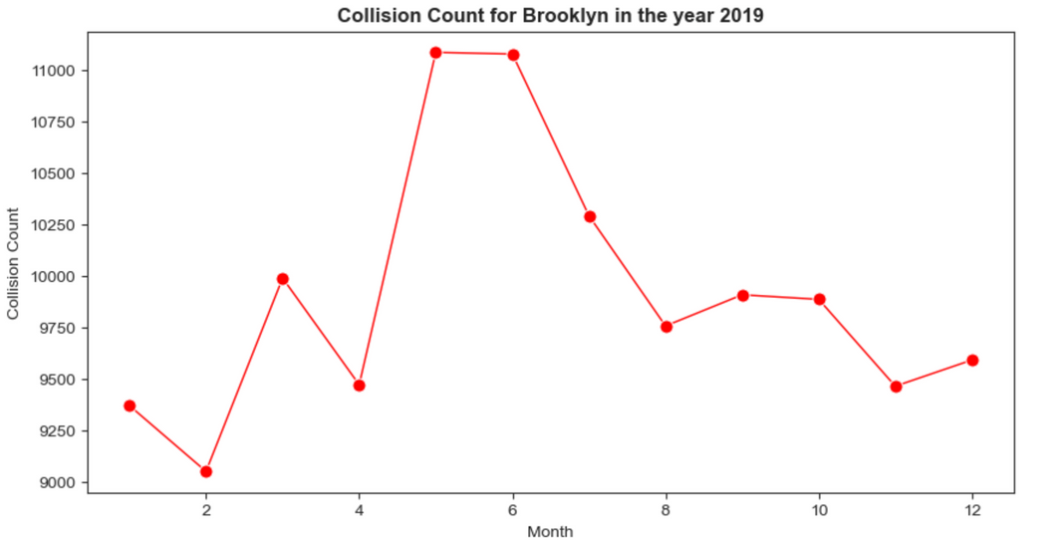
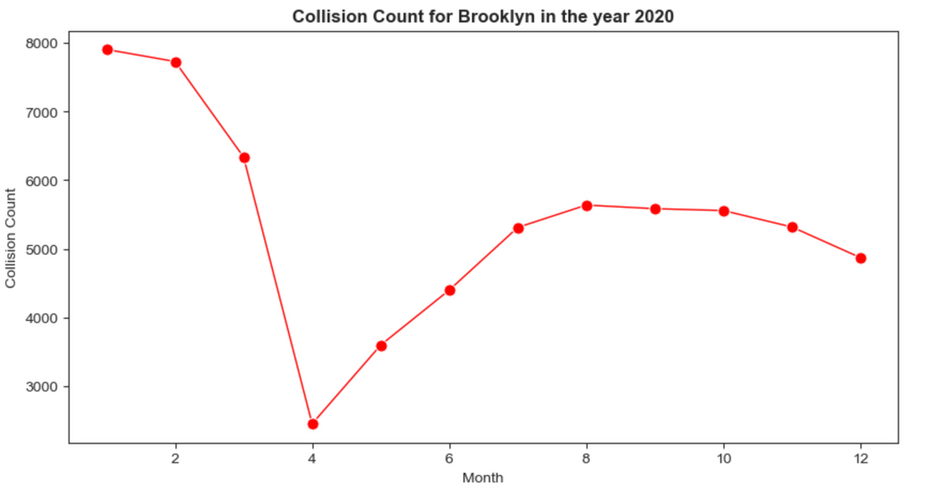
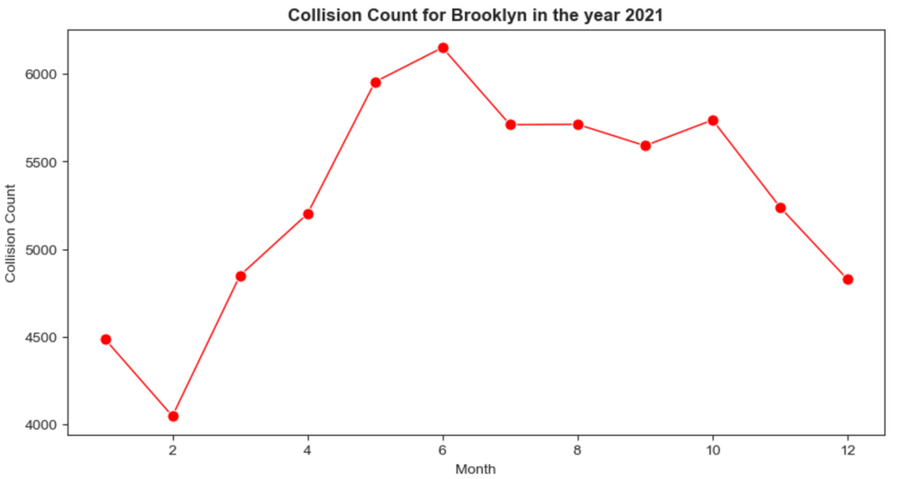
COLLISION COUNT IN BROOKLYN (2018-2021)

Slide 25
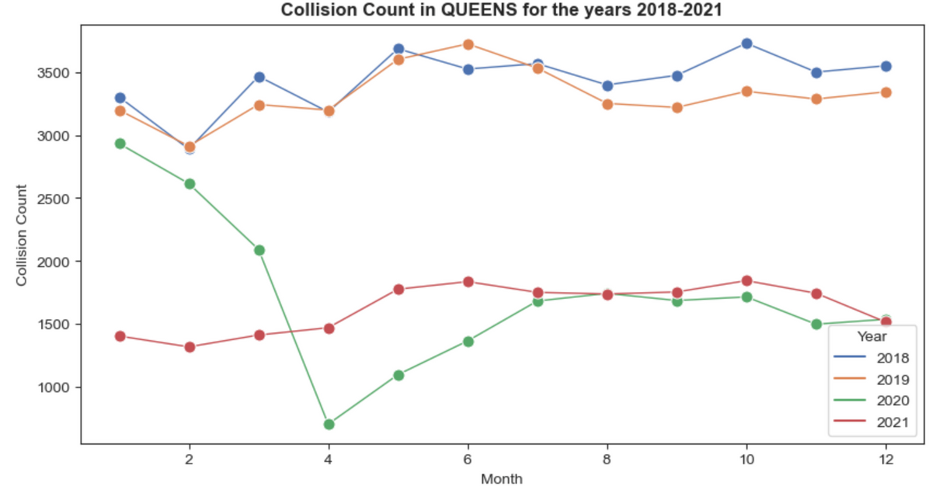
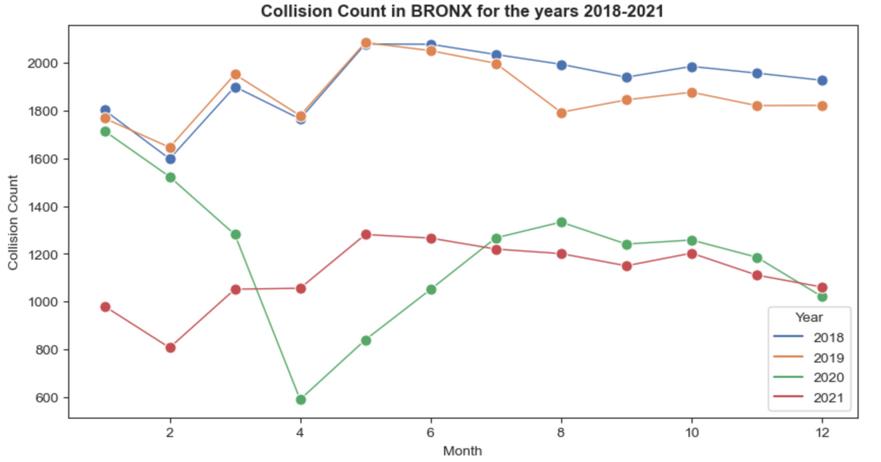
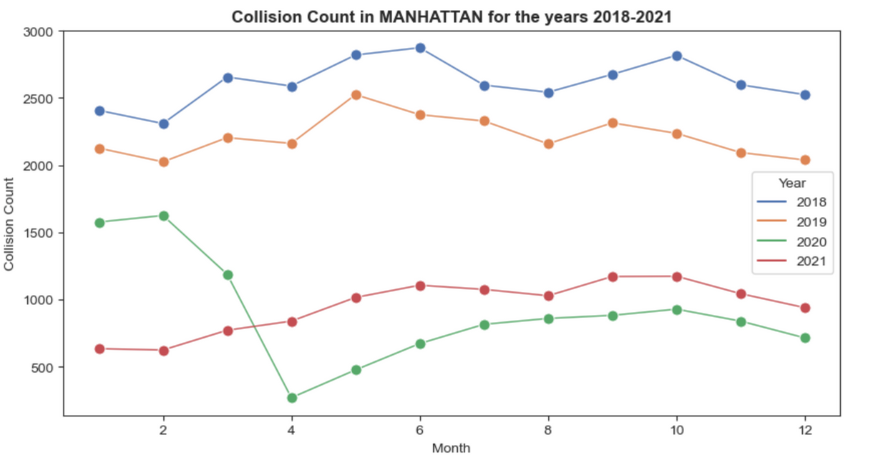
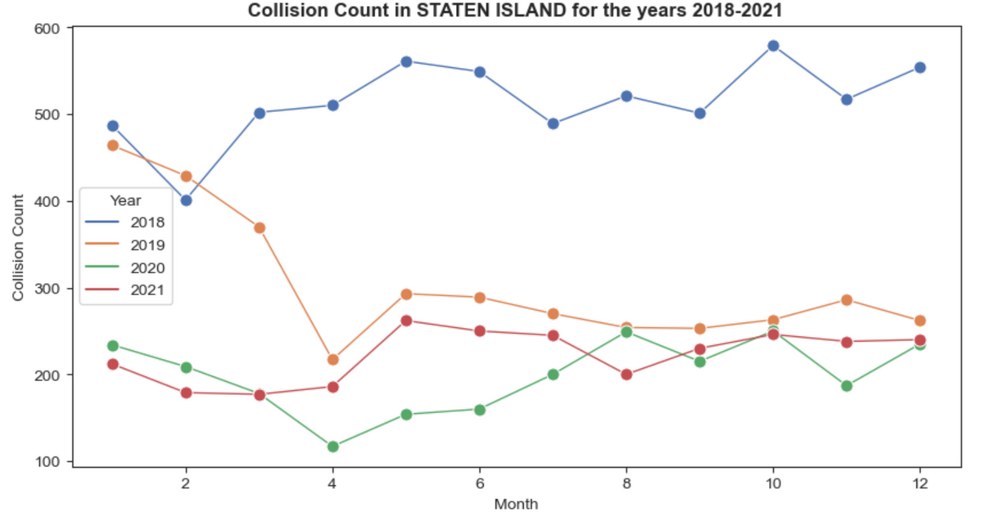

Slide 26
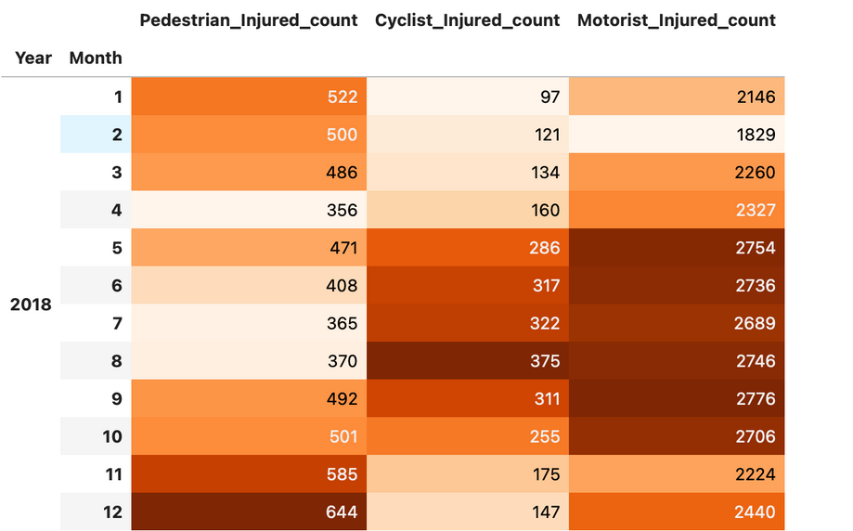
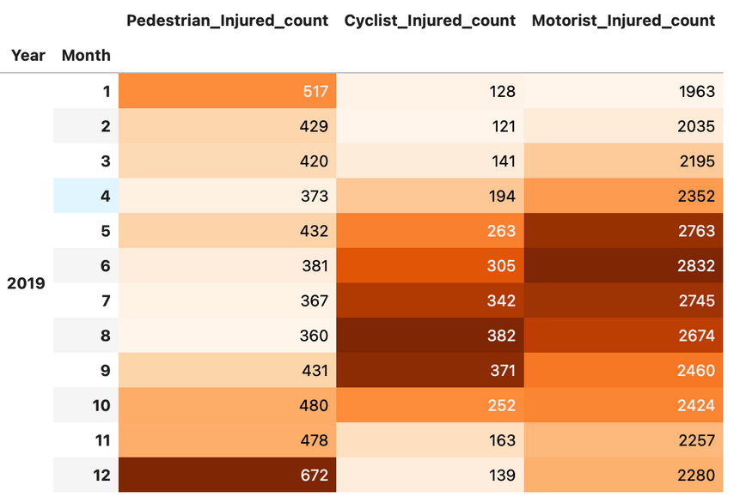
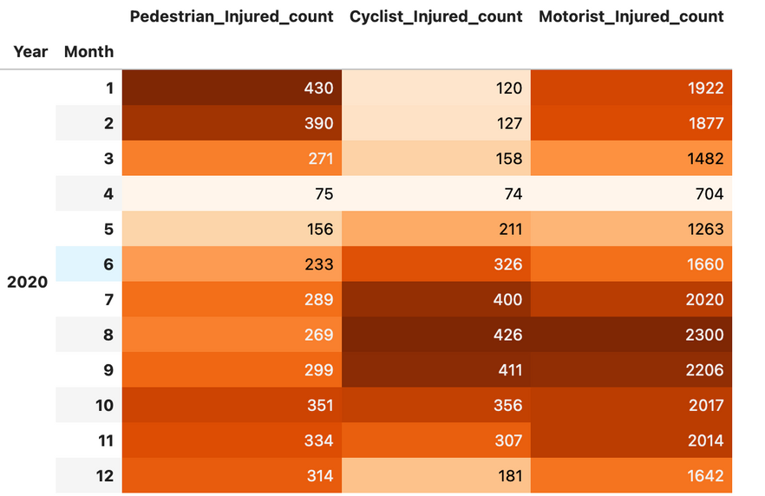
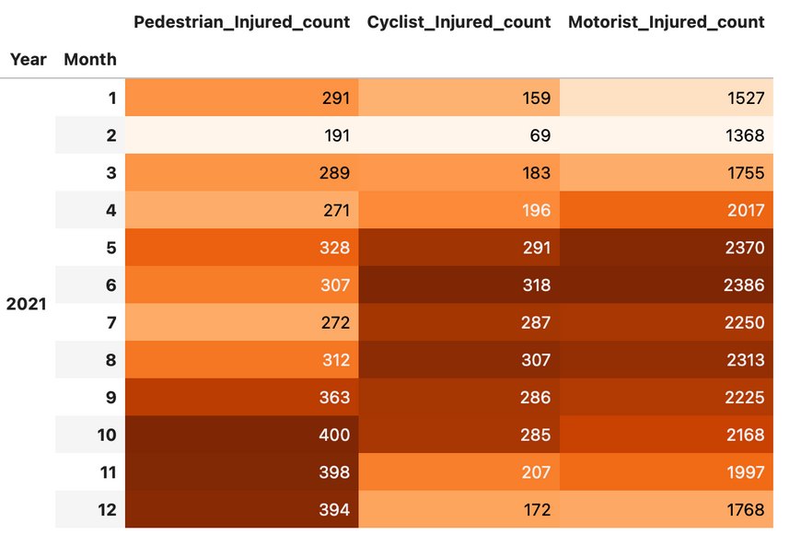
INJURED COUNT BY TYPE IN BROOKLYN

Slide 27
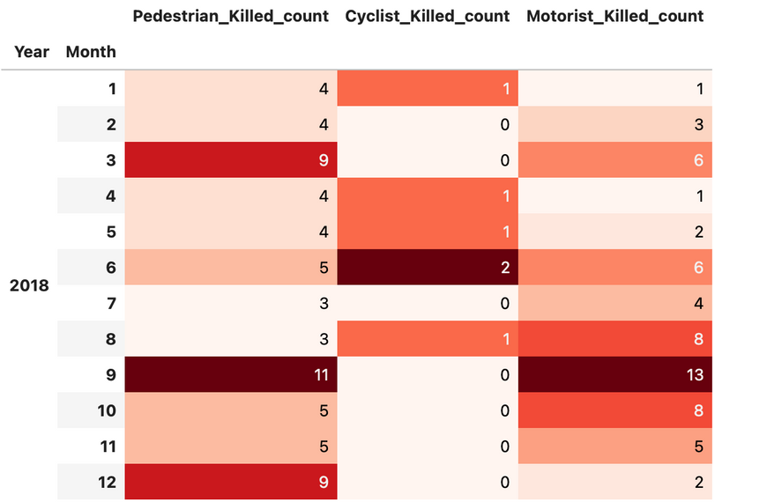
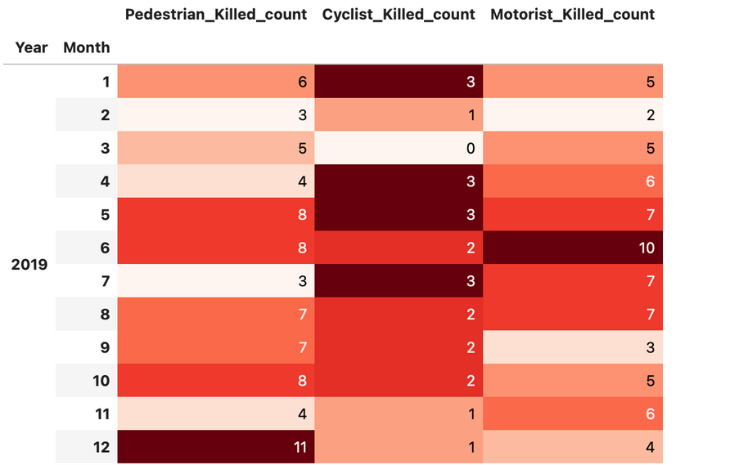
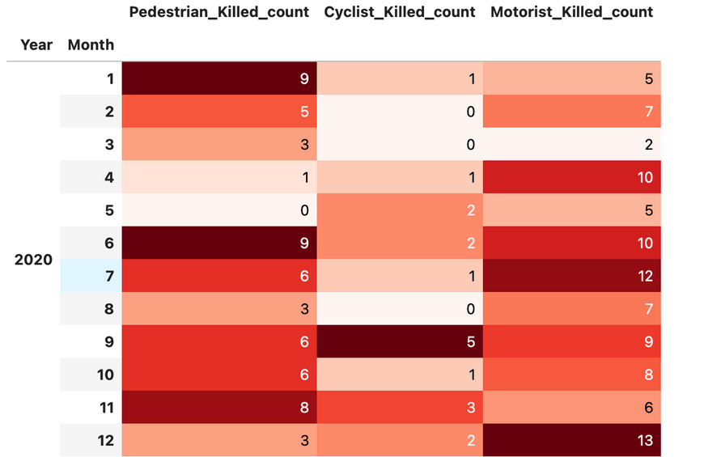
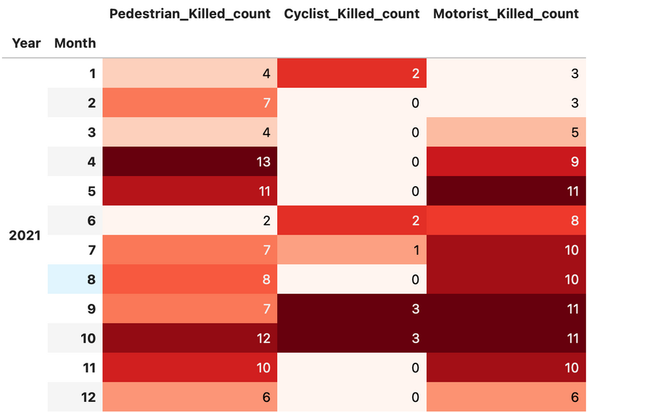
KILLED COUNT BY TYPE IN BROOKLYN

Slide 28




TOTAL KILLED & INJURED BY TYPE IN EACH BOROUGH

Slide 29




TOTAL KILLED & INJURED BY TYPE IN EACH BOROUGH

Slide 30

DISTRIBUTION OF COLLISIONS BY DAY OF THE WEEK AND HOUR OF THE DAY IN EACH BOROUGH
Most of the collisions happened between 8AM - 7PM
Max collisions count can be seen during 2PM - 7PM
On Mon, Tue, Fri, Sat, Sun we can see more collisions happening between 8AM - 7PM

Slide 31



Slide 32



Slide 33
The collision count was notably high during the months of May and June in almost every year, except for 2020 due to COVID-19 lockdown measures. Several reasons may account for this sudden rise in collisions:
Summer holidays lead to increased outdoor activities such as cycling and walking, contributing to greater pedestrian and cyclist traffic.
The peak tourist season during these months results in increased overall traffic volume, potentially leading to congestion and a higher risk of collisions.
Construction projects are often more prevalent during the summer months, leading to road closures, altered traffic patterns, and increased hazards on the roadways.
The collision trends in other boroughs were largely consistent
As observed earlier, the number of injured and killed individuals is higher among motorists. The count of injuries for motorists and cyclists was consistently high in Brooklyn every year, particularly after the month of May
In Queens and Manhattan, the count of pedestrians and motorists killed was high, while the count of injured motorists was also high. In Bronx and Staten Island, the count of pedestrians and motorists killed was high, while the count of injured motorists was also high.
It seems that most of the motorists and pedestrians were injured or killed in the collisions that occurred.
It seems that the distribution of collisions across hours of the day and days of the week is almost consistent across all boroughs.

Slide 34
THANK YOU

